Slide 1
Communication SUPERPOWERS
And how to harness them…
Karla M. Hunter, Ph.D. for Upward Bound, Summer 2023

Slide 2
THINK-PAIR-SHARE:
1) Who are some people you look up to as “COMMUNICATION SUPERHEROES”?
2) What makes them great communicators?

Slide 3
DISCUSS:
1) How can you be like them?
2) How are you already like them?

Slide 4
“The one easy way to become worth 50 percent more than you are now—at least— is to hone your communication skills
—both written and verbal”
Warren Buffett,
Investment Guru worth 60 Billion Dollars!
BOOM!!!!

Slide 5
Effective Communication
involves understanding and sharing meaning.

Slide 6
THREE SUPERPOWERS
Making Invisible Things Visible
Velocity
Strength
Metacommunication helps us establish HOW we will communicate as a team
Slow is fast…taking time to build, strengthen, and repair our relationships makes our tasks more efficient and effective.
There is strength in maintaining focus on connecting/partnering WITH our conversational partners, as opposed to trying to “win”

Slide 7
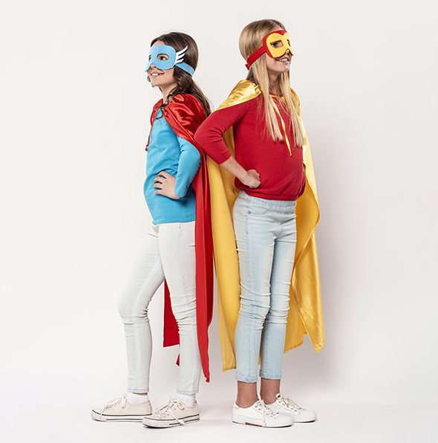
Storytelling SuperPowers…
Remember what helps you make your point clear and memorable…
Your points are simple and believable.
Your story has an organizational pattern (chronological, topical, spatial, or thematic)
You make your stories memorable through visual language, humor, or verbal tools
(e.g., rhyme, alliteration, onomatopea)!
And the most important thing: Make sure the audience can relate to you. In most cases, it’s ok to show your vulnerabilities!

Slide 8

YOUR OWN DISCOVERIES: Principles for Effective Teamwork
Understand and Respect Diversity, both externally and in ways of thinking/knowing, seeing the world
Build Relationships (quality time; icebreakers, fun/lighten the mood)
Establish ground rules and/or procedures
Make sure all voices are heard, especially hesitant ones!
Be a communication superhero!
B OM

Slide 9
HEROES VS VILLAINS
Villains
Multitasking
vs
Heroes
Listening

Slide 10
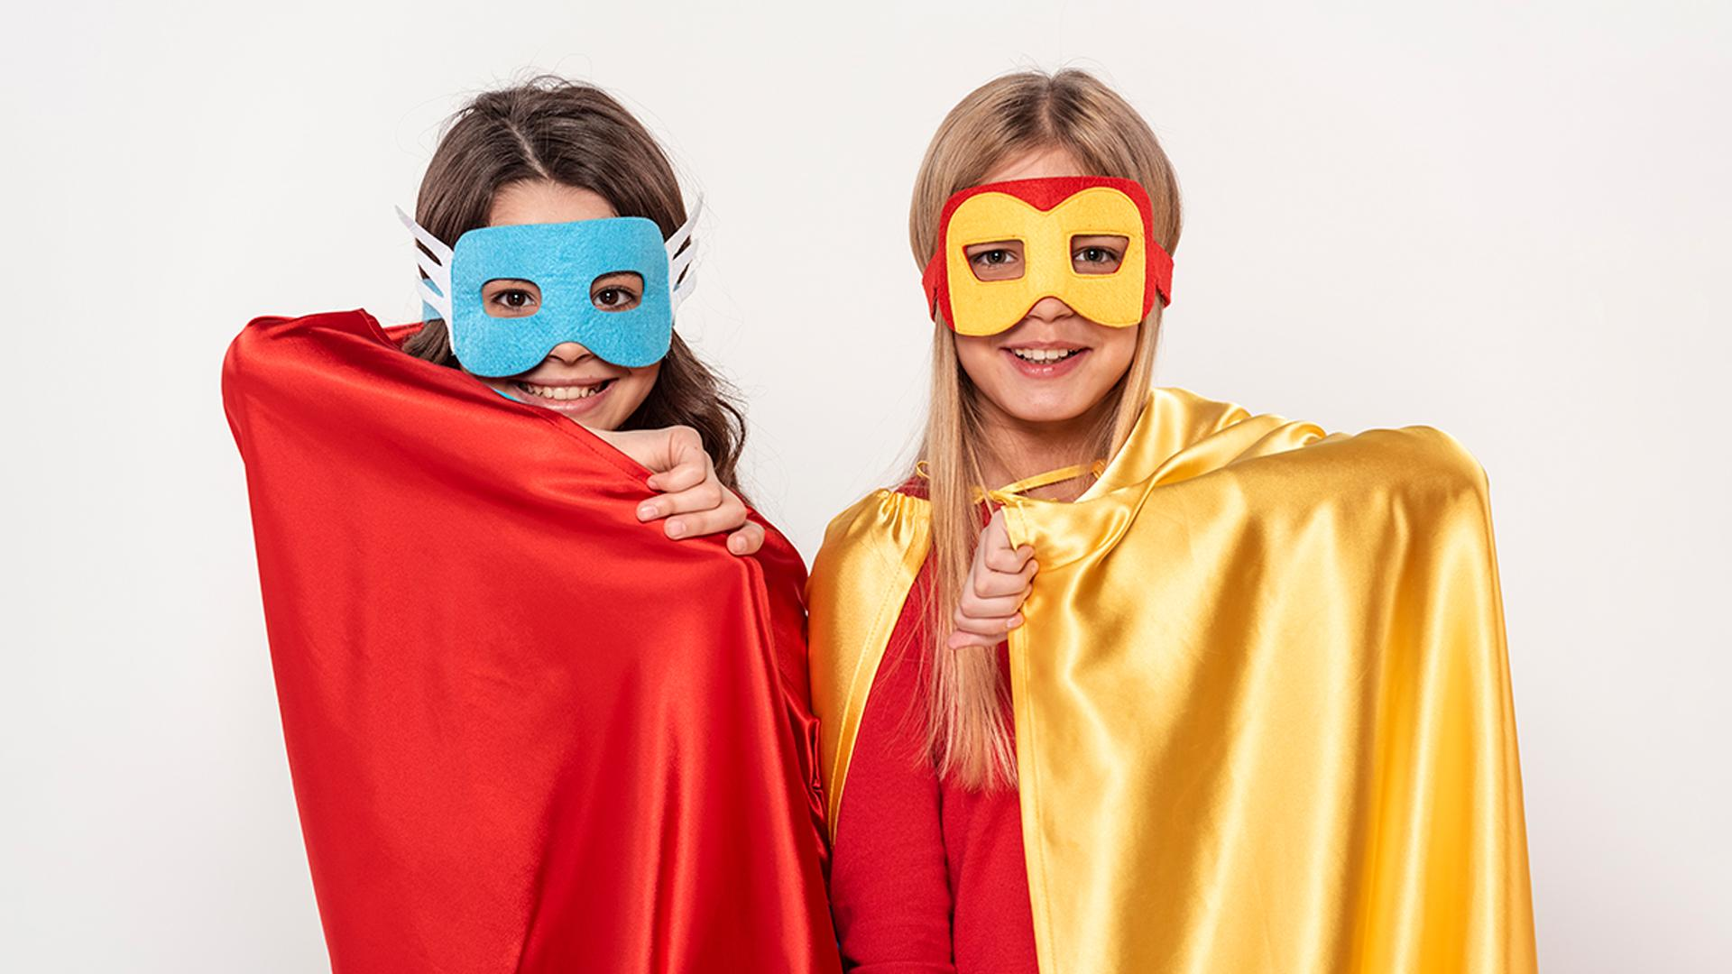
Nonverbal Communication:
A picture is worth a thousand words

Slide 11
Intercultural Competency
Conflict Management
Hofstede’s Research
Thomas and Killman

Slide 12
THANKS!
Do you have any questions?
youremail@freepik.com
+91 620 421 838
yourcompany.com
Please keep this slide for attribution

